Slide 1

DEPT OF INFORMATION TECHNOLOGY
RISHABH DEV
2K14/IT/56
SELF STUDY PRESENTATION

Slide 2

BARRELFISH
OPERATING SYSTEM

Slide 3
CONTENTS
INTRODUCTION
WHAT IS AN OPERTING SYSTEM
MAIN GOALS OF AN OPERATING SYSTEM
WHY DO WE NEED BARRELFISH?
BARRELFISH OS ARCHITECTURE
CONCLUDING REMARKS

Slide 4

INTRODUCTON
Barrelfish is a multi kernel operating system being developed collaboratively by researchers in the Systems Group at ETH Zurich in Switzerland and at Microsoft Research. It consists of a small kernel running on each core (one kernel per core), and while rest of the OS is structured as a distributed system of single-core processes atop these kernels. Barrelfish is written from scratch, almost all in C or assembler, and it runs on x86 platforms, with ports to various other platforms in progress.

Slide 5
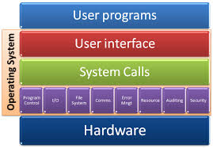
OPERATING SYSTEM
An Operating System (OS) is system software that manages computer hardware and software resources and provides common services for computer programs. The operating system is a component of the system software in a computer system.

Slide 6

Main Goals of OS
Resource Management: Disk, CPU cycles, etc. must be managed efficiently to maximize overall system performance
Resource Abstraction: Software interface to simplify use of hardware resources
Virtualization: Supports resource sharing – gives each process the appearance of an unshared resource

Slide 7
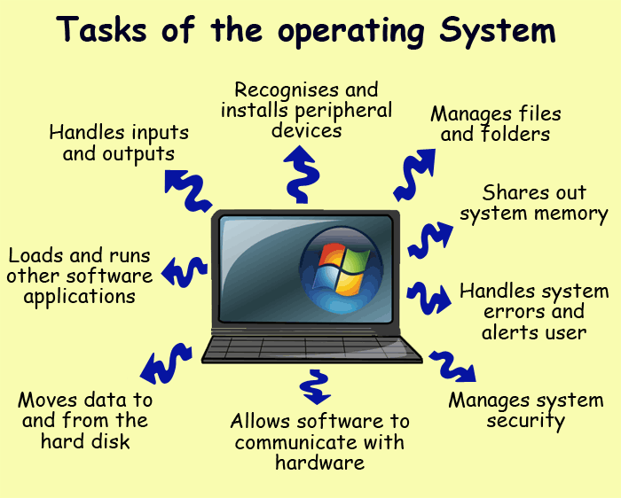

Slide 8
WHY DO WE NEED BARRELFISH?
The problem is that current operating systems were not designed to support computers with large numbers of processing cores. Efforts are afoot to make existing operating systems work well on existing hardware, but such attempts are incremental at best, and within five or 10 years, we’ll need a new paradigm.
In Barrelfish, each core has its own kernel and does not share memory as it does in Windows or Linux. Instead, the cores communicate by passing messages Passing messages between cores -- such as security information and other information to ensure the OS is running consistently -- is more efficient than sharing memory

Slide 9
But even if the Operating Systems know how to make use of multiple cores on a chip, most applications today aren't written to take advantage them. So companies such as Microsoft, Intel and Sun have been working to figure out how to write parallel code, which would allow applications to use a number of cores at the same time during processing.
The multikernel approach means Barrelfish could run on more diverse hardware since it separates the OS from the hardware. It means the base code of Barrelfish would not have to be altered as much as say, Windows or Linux have been in recent years in order to run on more advanced hardware.

Slide 10
To increase Scalability of computer system. SCALABILITY is the ability of a computer application or product (hardware or software) to continue to function well when it (or its context) is changed in size or volume in order to meet a user need. Typically, the rescaling is to a larger size or volume. The rescaling can be of the product itself (for example, a line of computer systems of different sizes in terms of storage, RAM, and so forth) or in the scalable object's movement to a new context (for example, a new operating system)

Slide 11
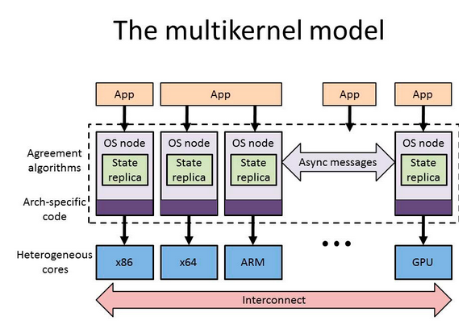
OS ARCHITECTURE

Slide 12
In this section we present our OS architecture for heterogeneous multicore machines, which we call the multikernel model. In a nutshell, we structure the OS as a distributed system of cores that
communicate using messages and share no memory. The multikernel model is guided by three design principles:
1. Make all inter-core communication explicit.
2. Make OS structure hardware-neutral.
3. View state as replicated instead of shared.
These principles allow the OS to benefit from the distributed systems approach to gain improved performance, natural support for hardware heterogeneity, greater modularity, and the ability to reuse algorithms developed for distributed systems.

Slide 13

CONCLUDING REMARKS
Computer hardware is changing faster than system software, and in particular operating systems. Current OS structure is tuned for a coherent shared memory with a limited number of homogeneous processors, and is poorly suited to efficiently manage the diversity and scale of future hardware architectures.
Barrelfish, an initial, relatively unoptimized implementation of the multikernel, already demonstrates many of the benefits, while delivering performance on today’s hardware competitive with existing, mature, monolithic kernels

Slide 14
REFERENCES
http://www.barrelfish.org/
Avi Silberschatz,Peter Baer Galvin and Greg Gagne, Operating System Concepts Eight Edition
P. E. McKenney and J. Walpole. Introducing technology into the Linux kernel: A case study. Operating Systems Review, July 2008
http://www.barrelfish.org/bffaq.html
S. Borkar. Thousand core chips: a technology perspective. In Proceedings of the 44th Annual Design Automation Conference.

Slide 15
THANK YOU

